Slide 1
Windows 11
How to get there…

Slide 2
Agenda
Windows 11 Overview
Windows 11 Requirements
Plan for Windows 11
Prepare for Windows 11
End User Adoption

Slide 3
Windows 11 Overview

Slide 4


Licensing
There are no unique licensing requirements for Windows 11.
Microsoft 365 licenses that include Windows 10 licenses will permit you to run Windows 11.
Volume license customers:
The Windows License will also cover Windows 11.

Slide 5
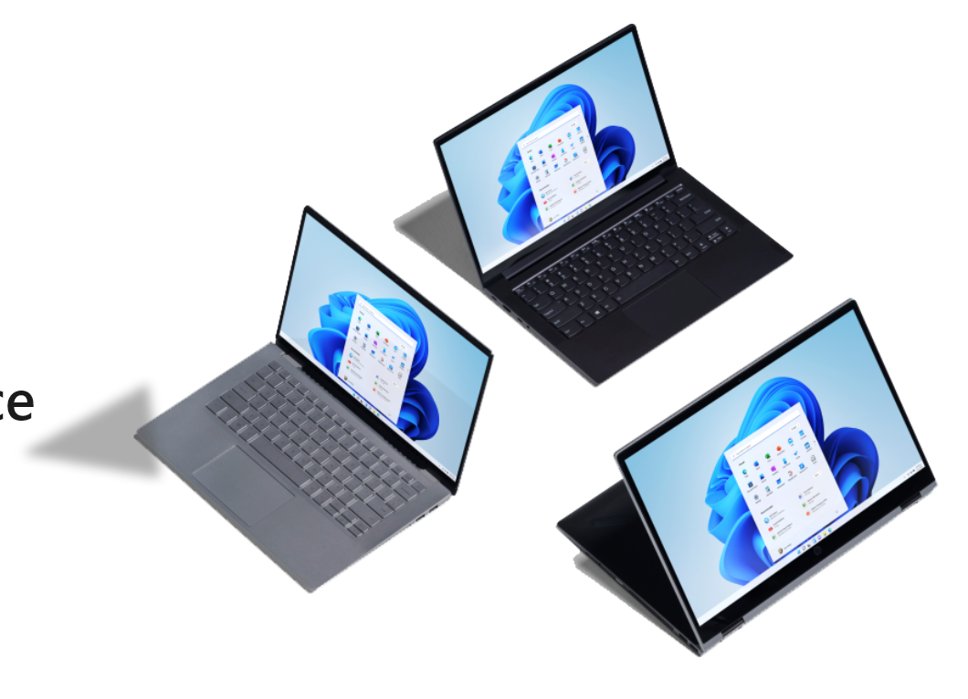
Compatibility
Drivers
Most accessories and associated drivers that work with Windows 10 are expected to work with Windows 11.
Applications
Preserves the application compatibility promise made with Windows 10
Does not require changes to existing support processes or tooling to sustain the currency of applications and devices.
Microsoft 365 customers can continue to use the App Assure program to support IT efforts to adopt and maintain Windows 11.

Slide 6
Servicing and Support
Quality updates:
Windows 11 and Windows 10 devices will receive regular monthly quality updates to provide security updates and bug fixes.
Feature updates:
Microsoft will provide a single Windows 11 feature update annually, targeted for release in the second half of each calendar year.
Lifecycle:
Home/Pro editions of Windows 11 will receive 24 months of support
Enterprise/Education editions of Windows 11 will be supported for 36 months

Slide 7
Windows 11 requirements

Slide 8

Hardware requirements
Processor: 1 gigahertz (GHz) or faster with two or more cores
Compatible 64-bit processor or system on a chip (SoC).
RAM: 4 gigabytes (GB) or greater.
Storage: 64 GB
Graphics card: Compatible with DirectX 12 or later, with a WDDM 2.0 driver.
System firmware: UEFI, Secure Boot capable.
TPM: Trusted Platform Module (TPM) version 2.0.
Display: High definition (720p) display, 9" or greater monitor, 8 bits per color channel.

Slide 9

Virtual Machine Support
Configuration requirements apply to VMs running Windows 11
Generation: 2
Storage: 64 GB or greater
Security: Secure Boot capable, Virtual TPM enabled
Memory: 4 GB or greater
Processor: 2 or more virtual processors

Slide 10
Plan for Windows 11

Slide 11

Deployment Planning
High level, this strategy should include the following steps:
Create a Deployment Plan
Define Readiness Criteria
Evaluate Infrastructure and Tools
Determine Application Readiness
Define your servicing strategy

Slide 12
Prepare for Windows 11

Slide 13

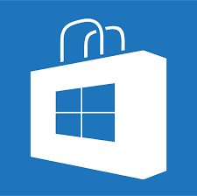
Infrastructure and Tools
On-premises solutions
Windows Server Update Service (WSUS)
Microsoft Endpoint Configuration Manager
Cloud-based solutions
Windows Update for Business
Microsoft Intune (Microsoft 365 E3)
Microsoft Business Store
The new Business Store will not be supported by MEMCM

Slide 14
Windows 11 Feature Update Blocks
https://github.com/AdamGrossTX/FU.WhyAmIBlocked
https://www.asquaredozen.com/2020/07/26/demystifying-windows-10-feature-update-blocks/
https://www.powershellgallery.com/packages/FU.WhyAmIBlocked/1.0.0.8

Slide 15
Desktop Device Customizations

Slide 16
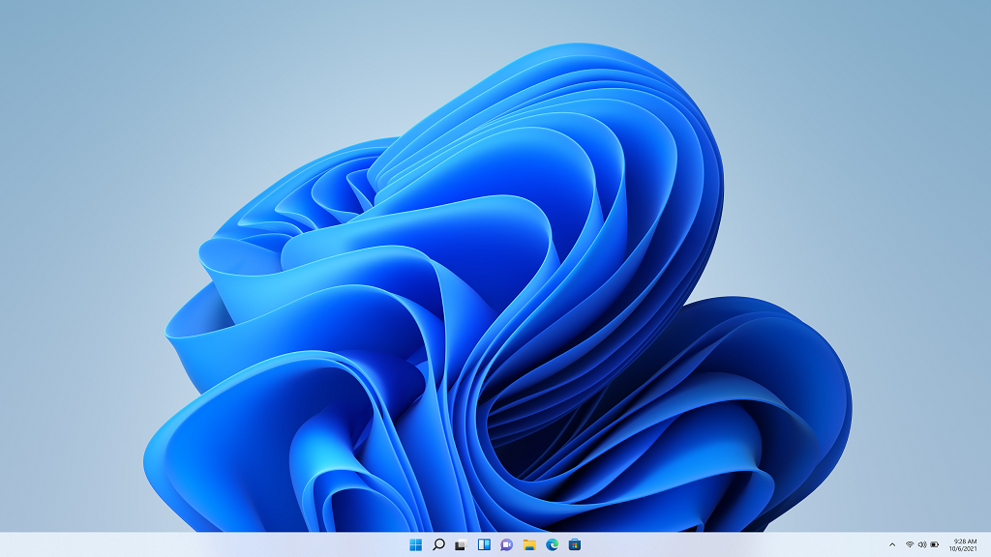
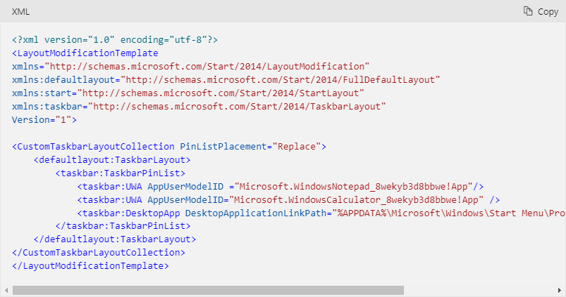
Customize the Windows 11 Taskbar
TaskbarLayoutModification.xml
https://docs.microsoft.com/en-us/windows-hardware/customize/desktop/customize-the-windows-11-taskbar

Slide 17
Customize the Windows 11 Start layout
Inspiration
https://docs.microsoft.com/en-us/windows-hardware/customize/desktop/customize-the-windows-11-start-menu

